Slide 1
Utility classes
StringTokenizer
Bit Set
Date
Calendar
Random
Formatter
Scanner

Slide 2
StringTokenizer class
Parsing is the division of text into a set of discrete parts, or tokens, which in a certain sequence can convey a semantic meaning.
The StringTokenizer class does parsing i.e., divides the text into tokens, often called the lexer (lexical analyzer) or scanner.
StringTokenizer implements the Enumeration interface.
To use StringTokenizer, we specify an input string and a string that contains delimiters.
Delimiters are characters that separate tokens.
Each character in the delimiters string is considered a valid delimiter—for example, ",;:" sets the delimiters to a comma, semicolon, and colon.
The default set of delimiters consists of the whitespace characters: space, tab, form feed, newline, and carriage return.

Slide 3
StringTokenizer
Constructors:
StringTokenizer(String str)
StringTokenizer(String str, String delimiters)
StringTokenizer(String str, String delimiters, boolean delimAsToken)
Here, str is the string that will be tokenized.
In the first version, the default delimiters are used.
In the second and third versions, delimiters is a string that specifies the delimiters.
In the third version, if delimAsToken is true, then the delimiters are also returned. as tokens when the string is parsed. Otherwise, the delimiters are not returned

Slide 4
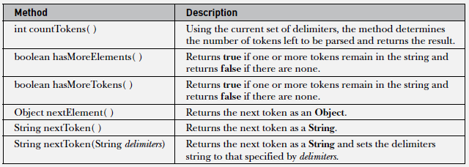
StringTokenizer - Methods

Slide 5

// Demonstrate StringTokenizer.
import java.util.StringTokenizer;
class STDemo
{
public static void main(String args[])
{
String in = "title:Java: The: Complete: Reference";
StringTokenizer st = new StringTokenizer(in, ":");
while(st.hasMoreTokens())
{
String val = st.nextToken();
System.out.println(val + "\t");
}
}
}

Slide 6
BitSet class
A BitSet class creates a special type of array that holds bit values in the form of boolean values.
This array can increase in size as needed.
Constructors:
BitSet( )
BitSet(int size)
All bits are initialized to false.

Slide 7
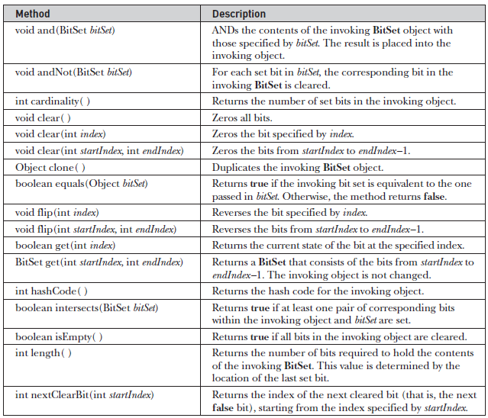
BitSet - Methods

Slide 8
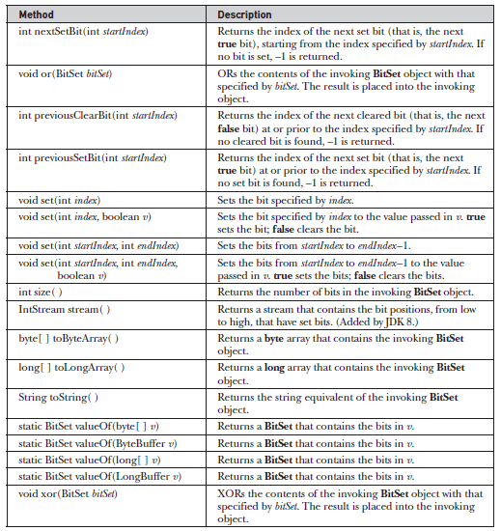
BitSet - Methods

Slide 9
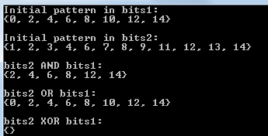
// BitSet Demonstration.
import java.util.BitSet;
class BitSetDemo
{
public static void main(String args[])
{
BitSet bits1 = new BitSet(16);
BitSet bits2 = new BitSet(16);
// set some bits
for(int i=0; i<16; i++)
{
if((i%2) == 0) bits1.set(i);
if((i%5) != 0) bits2.set(i);
}
System.out.println("Initial pattern in bits1: ");
System.out.println(bits1);
System.out.println("\nInitial pattern in bits2: ");
System.out.println(bits2);
// AND bits
bits2.and(bits1);
System.out.println("\nbits2 AND bits1: ");
System.out.println(bits2);
// OR bits
bits2.or(bits1);
System.out.println("\nbits2 OR bits1: ");
System.out.println(bits2);
// XOR bits
bits2.xor(bits1);
System.out.println("\nbits2 XOR bits1: ");
System.out.println(bits2);
} }

Slide 10
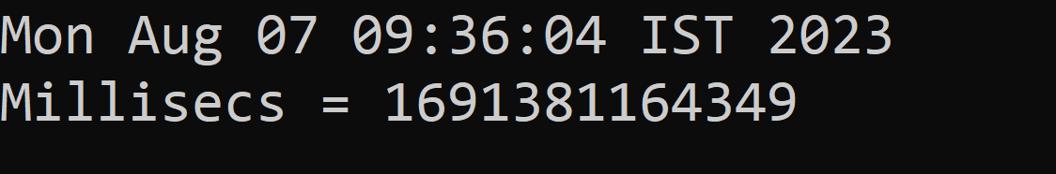
Date class
The Date class encapsulates the current date and time.
java.util.Date class represents date and time in java.
Constructors:
  Date() //initializes the object with current date & Time
  Date(long millisec) // Accepts one arguments that equals the number of milliseconds that have elapsed since Jan 1, 1970.
Program:
import java.util.*;
public class Datedemo
{
public static void main(String args[])
{
Date date=new Date();
System.out.println(date);
long msec = date.getTime();
System.out.println("Millisecs = " + msec);
}
}

Slide 11
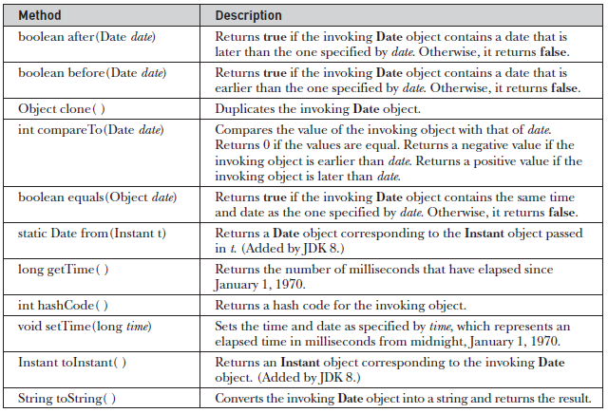
Date class- Methods
Note: Date class is moved into the Calendar and DateFormat classes

Slide 12
Calendar
calendar present in java.util package.
The Calendar class provides support for:
  Maintaining a set of calendar fields such as YEAR, MONTH, DAY_OF_MONTH, HOUR, MINUTE, SECOND, MILLISECOND; and
  Manipulating these calendar fields, such as getting the date of the previous week.
Methods of Java Calendar
  void add(int field, int amount) - It is used to add or subtract the specified amount of time to the given calendar field
  int get(int field) ------------It is used to return the value of the given calendar field.
  void set(int field, int value)----It is used to set the given calendar field to the given value.
  void setTime(Date date) -It is used to set this Calendar's time with the given Date.
  Date getTime() ------It is used to return a Date object representing this Calendar's time value.
Program Example

Slide 13
import java.util.Calendar;
public class calendrdemo
{
public static void main(String[] args)
{
Calendar calendar = Calendar.getInstance();
System.out.println("At present Calendar's Year: " + calendar.get(Calendar.YEAR));
System.out.println("At present Calendar's Day: " + calendar.get(Calendar.DATE));
System.out.println("The current date is : " + calendar.getTime());
calendar.add(Calendar.DATE, -15);
System.out.println("15 days ago: " + calendar.getTime());
calendar.add(Calendar.MONTH, 4);
System.out.println("4 months later: " + calendar.getTime());
calendar.add(Calendar.YEAR, 2);
System.out.println("2 years later: " + calendar.getTime());
}
}

Slide 14
Random class
The Random class is a generator of pseudorandom numbers.
These are called pseudorandom numbers because they are simply uniformly distributed sequences.
Constructors:
Random( )
Random(long seed) - a seed, the starting point for the
random sequence

Slide 15
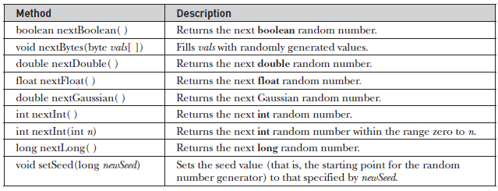
Random class - Methods

Slide 16

// Demonstrate random Gaussian values.
import java.util.Random;
class RandDemo
{
public static void main(String args[])
{
Random r = new Random();
System.out.println("random integer: " +r.nextInt());
System.out.println("random float: " +r.nextFloat());
System.out.println("random boolean: " +r.nextBoolean());
}
}

Slide 17
Formatter
The java.util.Formatter class provides support for layout justification and alignment, common formats for numeric, string, and date/time data.(like printf() in C)
Constructors
Formatter() This constructor constructs a new formatter.
Formatter(Appendable a) This constructor constructs a new formatter with the specified destination.
Formatter(File file) This constructor constructs a new formatter with the specified file.
Formatter(OutputStream os)
This constructor constructs a new formatter with the specified output stream.
Methods

Slide 18
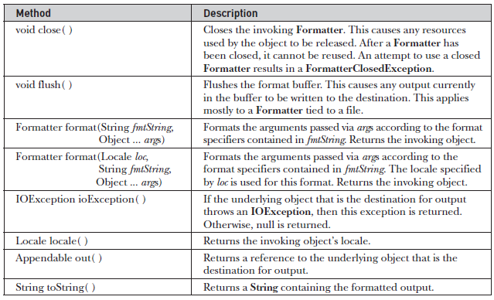
Formatter - Methods

Slide 19
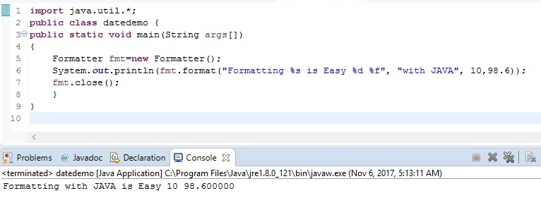
Formatter
Formatting Numbers
Formatting String

Slide 20
Scanner
Scanner is complement of Formatter.
It reads formatted input and converts it into its binary form.
Reads the file Test.txt:
  FileReader fin = new FileReader(“Test.txt”)
  Scanner src = new Scanner(fin);
Reads from standard input(keyboard)
  Scanner conin = new Scanner(System.in)

Slide 21
Scanner in=new Scanner(System.in);
System.out.println("enter your input ");
Scanner: Scanner is a class in Java that provides methods for parsing input from various sources, including standard input (keyboard).
in: in is a variable name (you can choose any valid variable name) used to refer to the Scanner object.
new Scanner(System.in): This part creates a new instance of the Scanner class, using the System.in argument. System.in is a special InputStream object associated with the standard input stream, which allows to read input from the user.

Slide 22
str=in.nextLine();
Once we have this Scanner object, we can use its methods like next(), nextInt(), or nextLine() to read different types of input from the user.
next():
This method reads the next token (a sequence of characters separated by whitespace) from the input as a String.
It skips leading whitespace and stops reading when it encounters whitespace.
It does not include the trailing newline character ('\n') in the returned string.

Slide 23
  next():
  Scanner in = new Scanner(System.in);
  System.out.print("Enter a word: ");
  String word = in.next();
  System.out.println("You entered: " + word);
nextInt():
This method reads the next token from the input as an int.
It expects the input to be a valid integer, and if the input is not an integer, it throws an InputMismatchException.
    Scanner in = new Scanner(System.in);
    System.out.print("Enter an integer: ");
    int number = in.nextInt();
    System.out.println("You entered: " + number);

Slide 24
nextLine():
This method reads the entire line of input as a String.
It reads until it encounters a newline character ('\n') or the end of the input.
It includes the newline character in the returned string.
  Scanner in = new Scanner(System.in);
  System.out.print("Enter a sentence: ");
  String sentence = in.nextLine();
  System.out.println("You entered: " + sentence);

